Slide 1
Data Visualization Design Exercises Design Exercise 1
Deconstructing visualization: Data, abstraction, data marks and channels

Slide 2
Design exercise 1: Deconstructing data
14:15-14:25: Introduction to design exercise 1
14:25-15:00: Work on exercise: Analyze, understand and deconstruct
15:00-15:15: Break
15:15-15:45: Redesign and revisualize the data
15:45-15:50: Display visualization on whiteboard/wall
15:50-16:00: Look at other groups' work and roundup
16:00 - ??: Fridaybar and 48 hour break – remember the hand-in on thursday!

Slide 3
Design exercise 1: Deconstructing data
You will be given a data visualization concerning climate change or the recent earthquake in Turkey and Syria. Your job is to analyze and deconstruct it. The visualization will be from Danish or international media.
Remember: to take pictures and document your process --> useful for your hand-in (23/2)!

Slide 4
Visualization 1: Denmark: Fluctuation in the average temperature 1873-2020
The graph shows a series of stripes that particularly illustrate the average temperature for one year. The colors in the visualization shows the fluctuations in the individual years in relation to the average annual mean temperature in the period 1981-2010. This was 8.3 °C. The blue stripes are below average, while the red ones are above.
The visualization is interactive!
Link: https://videnskab.dk/naturvidenskab/simpel-visualisering-af-den-globale-opvarmning-efterlader-ikke-meget-plads-til-tvivl

Slide 5
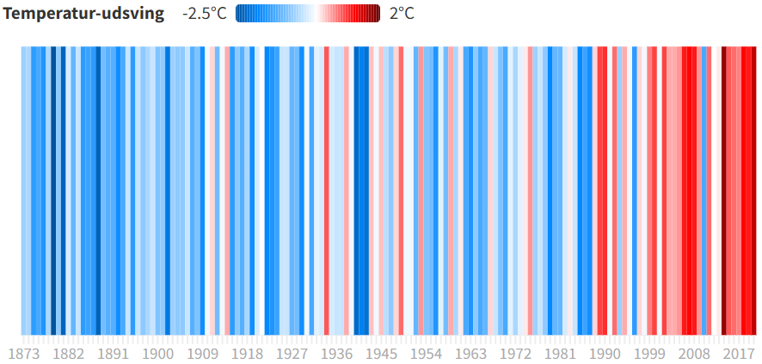
Visualization 1:
Temperature fluctuations
Year
Ed Hawkins klimaforsker ved University of Reading

Slide 6
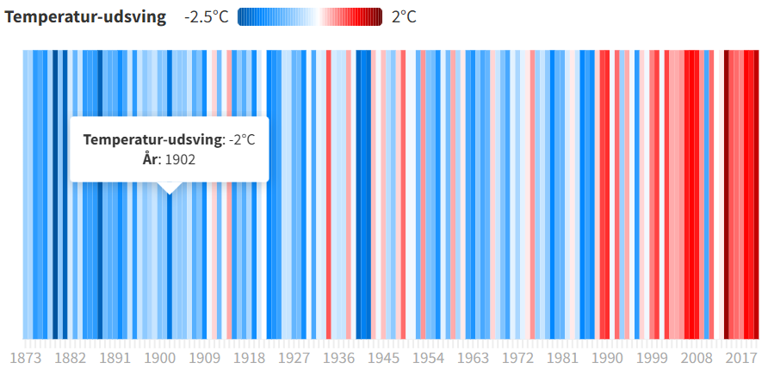
Visualization 1:
Temperature fluctuations
Year
Ed Hawkins klimaforsker ved University of Reading

Slide 7
Visualization 2: Turkey and Syria’s devastating earthquakes in graphics
The visualization shows the epicentres of the earth quakes hitting Turkey and Syria on the 6th of February 2023. It shows the shaking intensity as well as the placement of the tectonic plates in the area. It also shows the populated places in Turkey and Syria.
Link:
https://www.google.com/search?q=Turkey+and+Syria%E2%80%99s+devastating+earthquakes+in+graphics+financial+times&oq=Turkey+and+Syria%E2%80%99s+devastating+earthquakes+in+graphics+financial+times&aqs=edge.0.69i59j69i57j69i61.4189j0j9&sourceid=chrome&ie=UTF-8

Slide 8
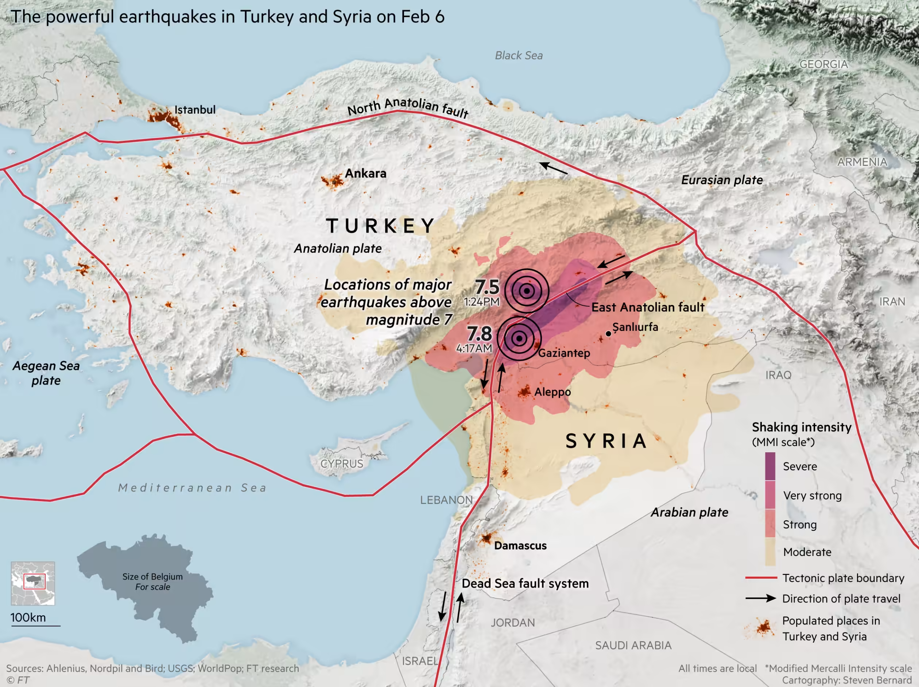
Visualization 2:

Slide 9
Visualization 3: Two future scenarios of rising water levels in Denmark
The visualization shows the rise in water levels around Denmark. 2 scenarioes is shown, controlled by an interactive glider.
Link:
https://www.dr.dk/nyheder/viden/klima/store-forskelle-paa-tvaers-af-danmark-havet-vil-stige-mere-i-esbjerg-end-i

Slide 10
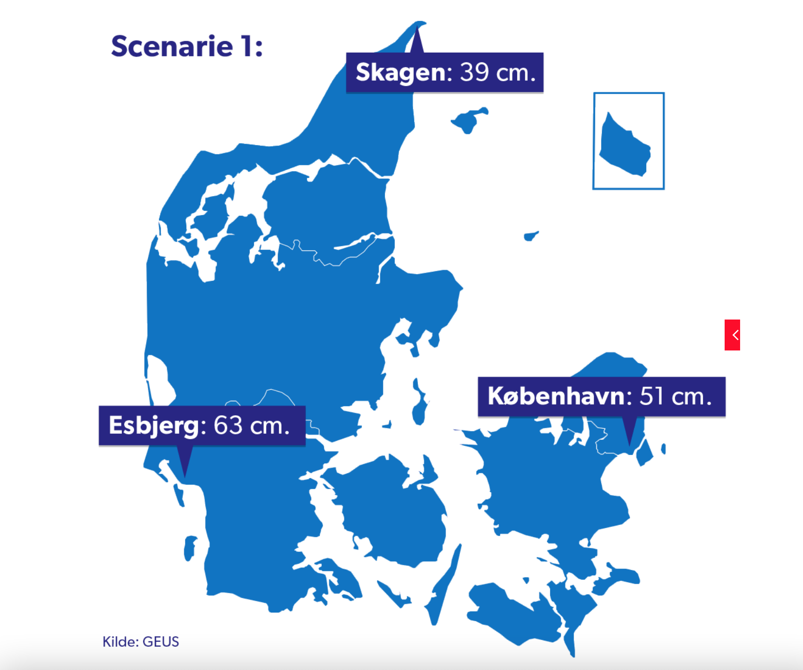
Visualization 3:

Slide 11
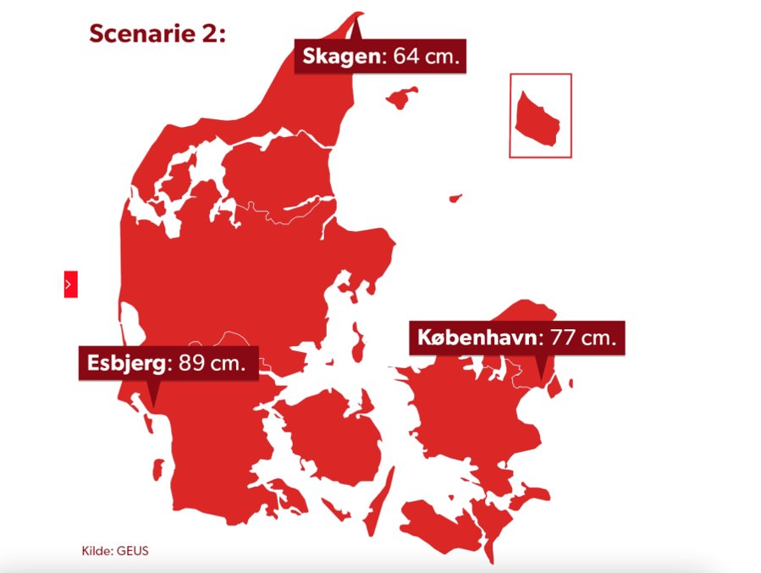
Visualization 3:

Slide 12
Visualization 4: CO₂ Emissions vs. Vulnerability to Climate Change by Nation
The blue circles represent the countries which are the most vulnerable due to carbon dioxide emission. This data viz is not from this year, but it’s still very impactful, not to mention beautiful. The data for this graphic was sourced from the Carbon Dioxide Information Analysis Center.
Link: https://visme.co/blog/climate-change-facts/

Slide 13
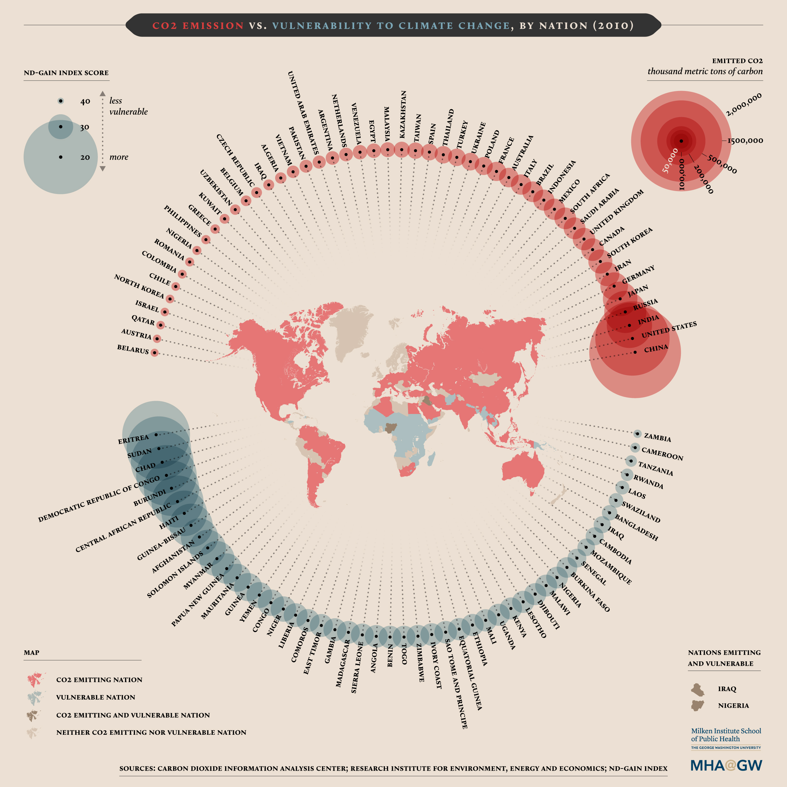
Visualization 4:

Slide 14
Visualization 5: Severe damages on the nature and environment
The article in unfortunately behind a paywall.
The article concerns the damages made on the environment, based on human factors.
Link: https://politiken.dk/klima/art9186151/Ny-beregning-punkterer-myten-om-gr%C3%B8n-v%C3%A6kst

Slide 15
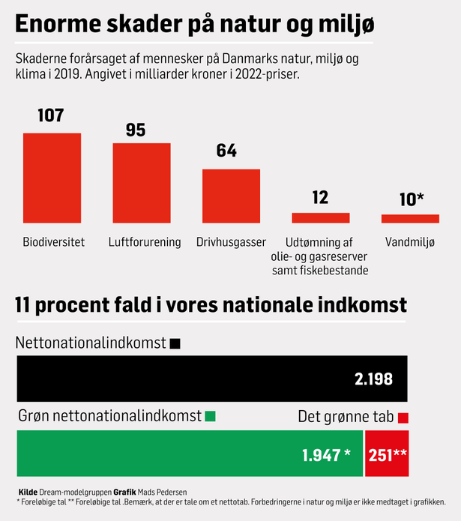
Visualization 5:

Slide 16
Helpful questions
What is the visualization about?
What does the visualization consist of?
Are there different types of values?
What kind of values are present/which values can we use in a redesign?
How can these values be presented, e.g. in a tabular form?
Which associations do we think of regarding the visualizations?
Etc. ...

Slide 17
Thank you!

